Slide 1
Poka-Yoke

Slide 2

Other Modules In This Series:
5S
Standard Work
Total Productive Maintenance (TPM)
Administrative Lean
Cell Design/ Production Preparation Process (3P)
Kaizen
Kanban
Problem Solving
Poka Yoke Quality Systems
Transaction Process Improvement (TPI)
Cause & Effect Diagram with the Additions of Cards (CEDAC)
Single Minute Exchange of Dies (SMED)
Value Stream Mapping (VSMi®)
Visual Management
Managing Daily Process Excellence
For More Information Please Contact:
Mark DeLuzio, President and CEO
+1.860.234.0915
mark.deluzio@leanhorizons.com
Strategically Creating Value Through the Elimination of Waste

Slide 3
This document contains confidential
and proprietary information owned
by Lean Horizons Consulting, LLC.
Any disclosure, use, copying or
distribution of this information without the express written consent of Lean Horizons Consulting is strictly prohibited.

Slide 4
Ground Rules for Event
Safety first (use personal protective equipment)
Active participation by all
Start and end on time
All electronic gadgets (phones, pagers, etc) turned to “off” or “silent”
Computers to be used only when instructed
Keep an open mind to change
Don’t let “perfect” get in the way of “better”
Notes:
DO: Perform Group Introductions. Pick an ice-breaker or exercise to warm the team up to the event. (Icebreaker Example: Everyone uses their name tent and writes a “Personal License Plate” in which they have 2 minutes to creatively use a total of 7 letters or numbers to tell us something about themselves. Examples “LV2SAIL” OR “DADOV5”
DO: Review Event Ground Rules.
ASK: “Does anyone have any rules they would like to see added?”
ASK: “Does everyone agree to these?”

Slide 5
Goal of Poka-Yoke Module
To apply the principles and practices of Poka-Yoke to achieve an improved quality target goal for your business.
Zero Defect
Quality
System
7 Steps
of Poka-
Yoke
Poka-Yoke
Examples
Notes:
DO: Introduce the notion of Poka-Yoke and the goal of this event.
SAY: “In this module we want you to learn the difference between defects and errors, learn how poka-yoke is a vital element of improving product quality, and learn how to implement poka-yoke in your value streams.”

Slide 6
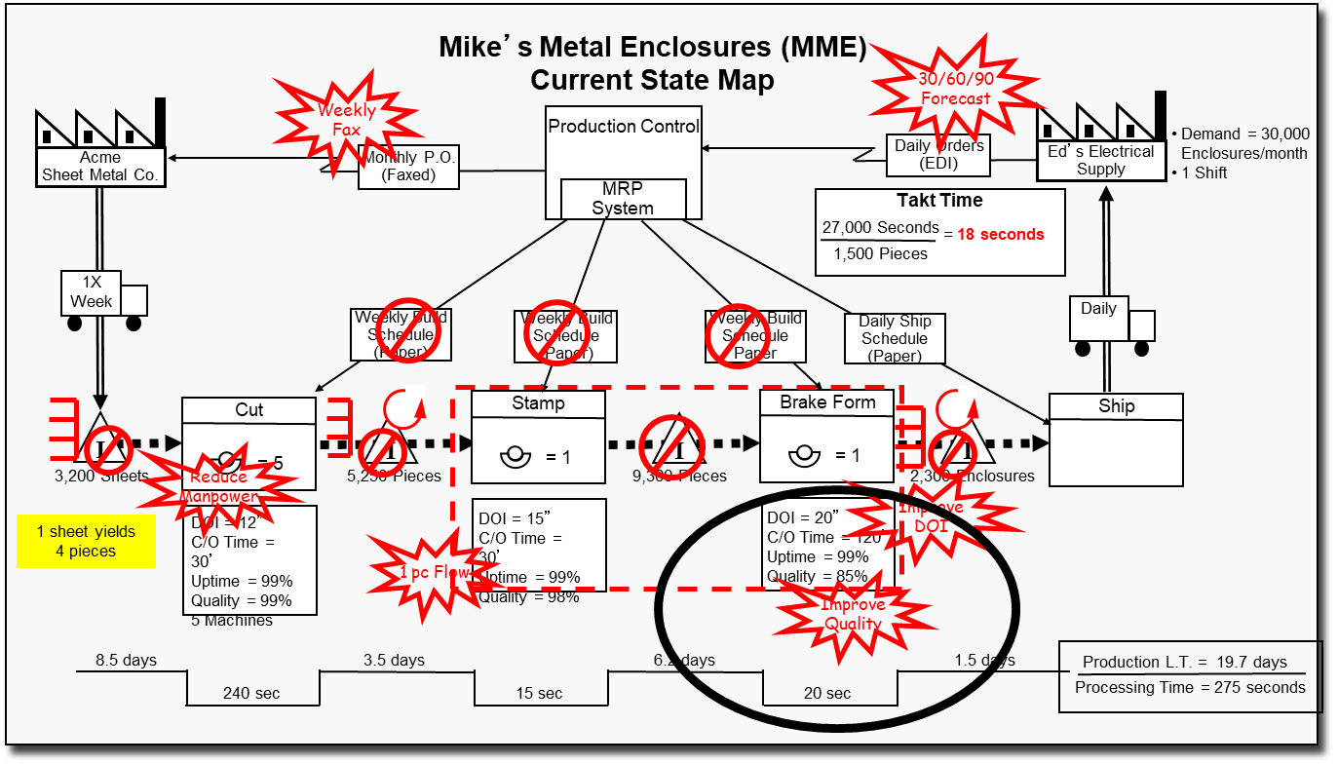
How did we get here?
Notes:
SAY: “As with all kaizen, our direction for our improvement efforts should be driven by a business need and/or the tool Value Stream Mapping.”
ASK: “Why?”
SAY: “We want to make sure we are going to get our “bang for the buck” with the investment we are making in our improvement efforts.”
ASK: “What business need is being met with our kaizen event this week?”
ASK: “Is there a Value Stream Map or a Value Stream Plan that identifies the need for this event?”

Slide 7
How did we get here?
Failure Mode and Effect Analysis
  Methodology for analyzing potential reliability problems early in the development cycle where it is easier to take action
  Used to identify potential failure modes, determine their effect on the operation of the product and identify actions to mitigate failures
  A crucial step to anticipating what might go wrong with a product or process
Notes:
DO: Define FMEA
SAY: “Customers are placing increased demands on companies for high quality, reliable products. The increasing capabilities and functionality of many products are making it more difficult for companies to maintain the quality and reliability. Traditionally, reliability has been achieved through extensive testing and use of techniques such as probabilistic reliability modeling. These are techniques done in the late stages of development. The challenge is to design in quality and reliability early in the development cycle.
Failure Modes and Effects Analysis (FMEA) is methodology for analyzing potential reliability problems early in the development cycle where it is easier to take actions to overcome these issues, thereby enhancing reliability through design. FMEA is used to identify potential failure modes, determine their effect on the operation of the product, and identify actions to mitigate the failures. A crucial step is anticipating what might go wrong with a product. While anticipating every failure mode is not possible, the development team should formulate as extensive a list of potential failure modes as possible.
The early and consistent use of FMEAs in the design process allows the engineer to design out failures and produce reliable, safe, and customer pleasing products. We do this by creating poka-yokes.”

Slide 8
Poka-Yoke: Error-Proofing
1
2
3
Poka-Yoke
Jidoka
Examples
A Japanese term meaning, “mistake-proof”
  Inadvertent errors (Poka)
  To avoid (yokeru)
A method of designing processes that will prevent errors
Also referred to as “autonomation”, means a method of transferring human intelligence to the process
The process detects abnormalities and stops when detected
Motion detect light switches room enter and exit
Car stops when object in path.
Auto shut-off irons
Automatic sinks in public restrooms
Low clearance barriers in parking garage
Notes:
DO: Review the Japanese origins and definition of the term, poka-yoke.
SAY: “Poka Yoke is also called mistake-proofing, error-proofing, and baka-yoke (fool proofing)”
SAY: “Poka-Yoke refers to methods that help associates avoid mistakes in their work caused by choosing the wrong item, leaving out an item, or any other form of doing something incorrectly.”
SAY: “Poka-yoke is the highest level of jidoka. Jidoka is another Japanese term that refers to providing systems, programs, and associates the ability to detect when an abnormal condition has occurred and immediately stop work. This allows associates to build quality into each process of their work.”
ASK: “What are other error proofing examples?”
Car safety belt warning light or buzzer
Clothes iron that shuts itself off if left on inadvertently
Garage door opener with safety reversing switch
Lawn mower with safety release handle for shutting off mower
A car that cannot be started in gear
Microwave ovens that will not start with the door open

Slide 9
Poka-Yoke Philosophy
Promotes defect prevention vs. defect detection
Recognizes that people forget and make errors, and machines and processes fail and make errors
Respects the intelligence of workers by taking the judgment out of repetitive tasks or actions where errors are likely to occur
Utilizes people working in the process to “mistake-proof” the process because they own the process
Notes:
DO: Review key points on the slide. As if anyone has experience implementing poka-yokes in the workplace and if yes, to share.

Slide 10

The Five Elements of Production
Introduction
4. METHOD
Control: Work standards
WORK STANDARD
5. INFORMATION
Control: Visual controls (e.g.: instruction sheets, kanban)
3. MACHINE
Control: Conditions assured through TPM and everyone’s participation
1. ME
Control: Discipline, fundamental education, cross-training assignments
2. MATERIAL
Control: Source controls
Notes:
SAY: “The five elements of production are Me (the operator), Material, Machine, Method, and Information. Each one of these elements has the capability of introducing variation into the process that can result in poor quality. When we error-proof a process, we want to take each of these five elements into consideration so that we can achieve process control.”

Slide 11
Why is Poka-Yoke an important concept?
Key element in our capability to eliminate waste
No need for “just in case” inventories
Allows company to make only what the customer needs
Maintain customer satisfaction and loyalty
Happy customers mean more sales
Always a cost associated with manufacturing defects
Notes:
SAY: “Poka-Yoke is a key element in our capability to implement Kaizen-Lean Manufacturing Systems. It is a key element in our capability to eliminate waste from: defects, inventories, motions, delays, processes, misused resources, untapped resources.”
SAY: “Consistency in quality will result in maintaining customer satisfaction and loyalty.”
SAY: “Think about all of the costs for producing defective work or errors. There are tremendous costs associated with re-work, materials, equipment expenses, shipping – not to mention the damage that happens to our relationship with our customers and how our products and brand are viewed.”

Slide 12
Error-Proofing
Introduction
Level 1 - Customer Inspects
Level 2 - End of Value Stream Inspection
Level 3 - End of Process Inspection
Level 4 - Perfect Quality Built In
Rework
A
B
C
Inspection
A B C
Ship
Scrap
A
B
C
Ship
Build in Quality
at Each Process
Notes:
DO: Review the 4 levels of error proofing.
SAY: “At the “Customer Inspects level, we are still allowing defects to get into the hands of customers.”
ASK: “What is wrong with stopping at Level 2? (we are waiting until after the 3rd process to check if we have a quality part… steps B and C could be working on defect (WASTE – and if they are working in batch even more so!)
SAY: At level 3 we are getting much better by inspecting at the end of each process (however we are adding time and resources to do so at every point).
SAY: “We want to reach a point (Level 4) where it is impossible to pass a defect onto the next process. In this section will discuss ways to build quality into the product so that we can achieve this.”

Slide 13
Exercise: Poka-Yoke Charter Review
Introduction
Objective
Review the Poka-Yoke Charter for the event against charter criteria
Instructions
Time to Complete
As a team review the event charter and answer the following questions:
What is the business need for this event?
Who is the owner?
What are the goals for this event?
30 minutes
Deliverable
Make any modifications
to charter as necessary.
Notes:
DO: Review the charter for this event.

Slide 14
Zero Defect Quality System
Zero Defect
Quality System
7 Steps of Poka-Yoke
Poka-Yoke Examples
Objectives:
Discuss difference between defects and errors
Discuss causes of defects
Define Zero Defect Quality (ZDQ) System
Review and discuss each component of the ZDQ System
Notes:
DO: Review section objectives on slide.

Slide 15
Discussion
Zero Defect Quality System
Objective
Discuss the difference between “defects” and “errors”
Instructions
Time to Complete
In pairs, discuss what you think the difference is between the terms “defects” and “errors”.
Discuss answers as a class
3 minutes
Deliverable
Class discussion of
answers
Notes:
DO: Have the class discuss the exercise in pairs and prepare their answers, or conduct this exercise as a large group calling upon people to share their answers.
SAY: “Defects are a result of errors that are made – so if you can reduce or eliminate the potential for error, you do the same for the potential for defects.”

Slide 16
What causes defects?
Zero Defect Quality System
1. Poor Procedures
or Standards
Human Mistakes:
Simple errors, the most common cause of defects, occur unpredictably
Ten Types of Human Mistakes:
  Forgetfulness
  Misunderstanding
  Wrong Identification
  Lack of Experience
  Willful ignoring
  Inadvertent or sloppiness
  Slowness
  Lack of standardization
  Surprise
  Intentional
2. Equipment
3. Non-conforming Material
4. Worn Tooling
5. Human Mistakes
Notes:
SAY: Human mistakes are the most common cause of defects.
DO: Review the 10 types of human mistakes.

Slide 17
Defects and Human Errors
Zero Defect Quality System
Human errors
Misunderstanding
Misidentification
Non-supervision
Intentional
Forgetful
Amateurs
Inadvertent
Slowness
Surprise
Willful
Causes of defects
Missed operations
Processing errors
Errors in part set-up
Missing parts
Wrong parts
Processing wrong work piece
Misoperation
Adjustment error
Improper equipment set-up
Improper tools and jigs
highly correlated
correlated
Notes:
ASK: “What does the correlation between the types of human mistakes and causes of defect tell you?”

Slide 18
What is a Zero Defect Quality (ZDQ) System?
Zero Defect Quality System
1
2
3
ZDQ Definition
ZDQ Components
Approaches to
Inspection
Based on a discipline that defects are prevented
Make certain that the required conditions are in place and controlled to make acceptable product 100% of the time
Point of Origin Inspection
100% Inspection
Immediate Feedback
Poka-Yoke
3 basic approaches:
  Judgment – Standard Inspection
  Informative Inspection
  Point of Origin Inspection
First two approaches are widely used and considered traditional
Only Point-of-Origin Inspection actually eliminates defects
Notes:
SAY: “A zero defect quality system makes certain that the required conditions are in place and controlled to make acceptable product 100% of the time.”
DO: Review the 4 components of ZDQ and approaches to inspection.

Slide 19
ZDQ Components
Zero Defect Quality System
    Point of Origin Inspection
100% Inspection
Immediate Feedback
Poka-Yoke

Slide 20
ZDQ Components
Zero Defect Quality System
    Point of Origin Inspection
100% Inspection
Immediate Feedback
Poka-Yoke

Slide 21
Point of Origin Inspection
Zero Defect Quality System
Check for optimum process conditions before processing is done and errors can be made
Instant feedback
Corrections made before defects occur

Slide 22
ZDQ Components
Zero Defect Quality System
    Point of Origin Inspection
100% Inspection
Immediate Feedback
Poka-Yoke

Slide 23
100% Inspection
Zero Defect Quality System
Point of Origin inspection on every piece
Differs from SQC inspection
  Does not rely on sampling
  Does not assume defects will statistically occur

Slide 24
ZDQ Components
Zero Defect Quality System
    Point of Origin Inspection
100% Inspection
Immediate Feedback
Poka-Yoke

Slide 25
Immediate Feedback
Zero Defect Quality System
Error correction as soon as possible
Differs from traditional inspection approaches that
  Correct problems after the process
  Address the problem when errors are already defects
  In some cases never identify an error has occurred

Slide 26
ZDQ Components
Zero Defect Quality System
    Point of Origin Inspection
100% Inspection
Immediate Feedback
Poka-Yoke

Slide 27
Poka-Yoke
Zero Defect Quality System
Does not rely on operators catching mistakes
Inexpensive Point of Origin inspection
Quick feedback 100% of the time

Slide 28
The 7 Steps of Poka-Yoke
Zero Defect
Quality System
7 Steps of Poka-Yoke
Poka-Yoke Examples
Objectives:
Identify the 7 steps of the Poka-Yoke process
Define and identify Red Flag conditions
Differentiate between prevention and detection error-proofing techniques
Discuss importance of developing a Process Stop Support Plan
Discuss use of visual controls when error-proofing is not possible
Notes:
DO: Review section objectives on slide.

Slide 29
7 Steps of Poka-Yoke
7 Steps of Poka-Yoke
Create a process map and identify the locations at which the defects are found and made
Evaluate current procedures for adequacy and determine if they are
being followed
Identify defect provoking conditions, or red flag conditions, at each
process step
Identify the root cause(s) (error) of each type of defect and in which process step it occurs
Identify the type of error-proofing device required
Create the device and try it
Measure for effectiveness
Notes:
DO: Review the seven steps.

Slide 30
Red Flag Conditions are conditions which normally provoke errors
7 Steps of Poka-Yoke
Multiple steps
Infrequent production
Lack of standards
Rapid repetition
High volume
Environmental conditions
  Material / process handling
  Housekeeping
  Ergonomics
Notes:
DO: Review Red Flag conditions.

Slide 31
Red Flag Conditions (continued)
7 Steps of Poka-Yoke
Adjustments
  Machines
  Programs
Templates / template changes
Low tolerance
Many transactions / Mixed transactions
Symmetry / Asymmetry
Notes:
DO: Review Red Flag conditions.

Slide 32
Errors may either be prevented or detected
7 Steps of Poka-Yoke
Technique | Prevention | Detection
Control (shut down) | An error is impossible | Defective item can’t move on to the next step
Warning | An error is about to be made | An error has been made
Notes:
SAY: “With error-proofing we can implement a control/shut down technique in the process – with prevention an error would be impossible, with detection, the defect would be unable to move onto the next step.
By implementing a warning technique, prevention methods would allow us to know that an error is about to be made, and detection methods would let us know that an error has just occurred.”

Slide 33


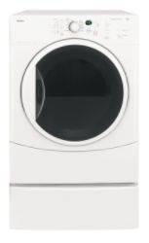
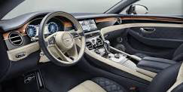
Control (Shutdown) Prevention and Detection Examples
7 Steps of Poka-Yoke
Prevention
Detection
Access controlled by biometric scan
Vehicle won’t start unless in park and brake depressed.
Laundry dryers that have a device that shuts them down when overheating is detected
A computer spell checker
Reprinted with permission from BigPhotoStock.com
Notes:
DO: Review examples.
ASK: “Are there others that you can think of?”

Slide 34
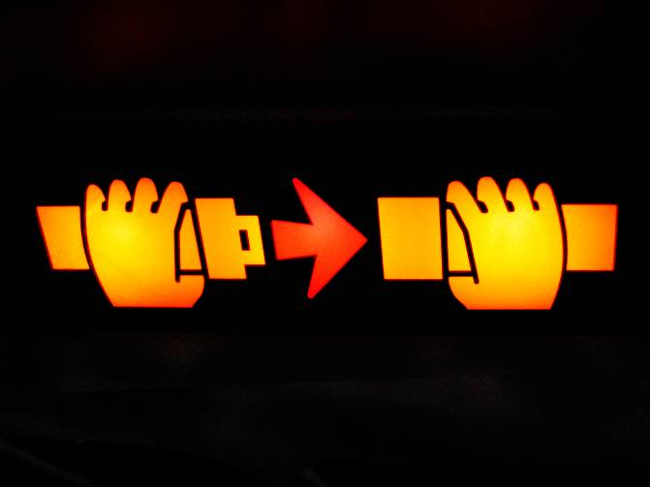
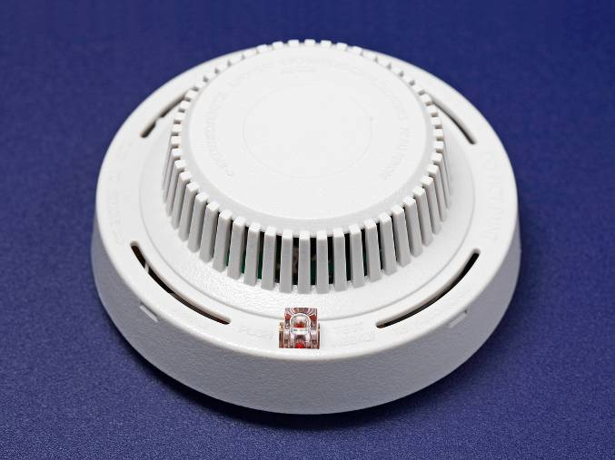
Warning Prevention and Detection Examples
7 Steps of Poka-Yoke
Prevention
Detection
Warning systems in automobiles to alert driver that not all seatbelts have
been fastened
Smoke detectors
Reprinted with permission from BigPhotoStock.com
Notes:
DO: Review examples.
ASK: “Are there others that you can think of?”

Slide 35
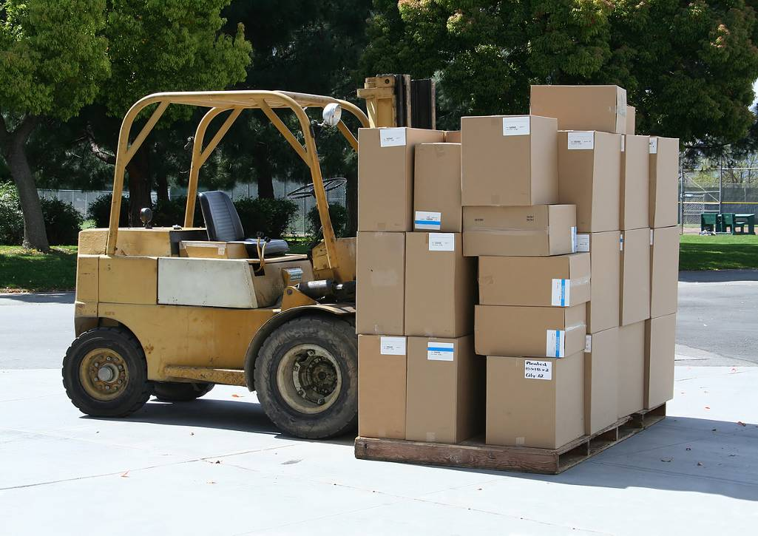
Error-Proofing Contact Methods
7 Steps of Poka-Yoke
Contact Methods
Electrical outlets assure proper polarity – it is impossible to put a plug in the outlet incorrectly
Guide or guide pins that assure proper insertion
Magnetic contacts that assure proper positioning
Two handed start buttons to avoid hand accidents
Pressure sensitive mats that stop dangerous pinching machinery when someone steps onto the mat
Limit switches on fork trucks that prevent the truck from moving while the driver’s seat is unoccupied
Reprinted with permission from BigPhotoStock.com
Notes:
DO: Review examples.

Slide 36
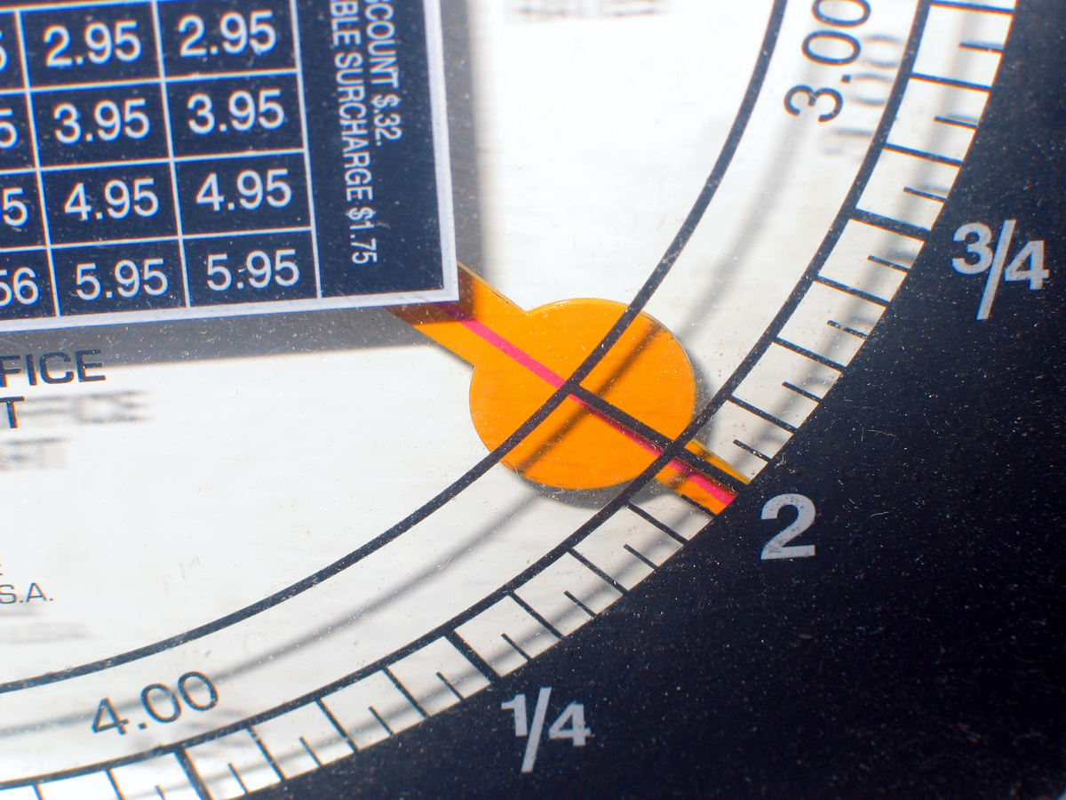
Error-Proofing Fixed Value Methods
7 Steps of Poka-Yoke
Fixed Value Methods
If four labels from different rolls are needed on each shipping box, put all the labels on one roll to make it easy to spot missed labels
Kitting is having the exact amount of material needed for one unit in one box. Makes it easy to catch missing components
Sensors that count parts as they are placed in a box
Scales to weigh packaging documentation and alert an operator to a missed document
Reprinted with permission from BigPhotoStock.com
Notes:
DO: Review examples.

Slide 37
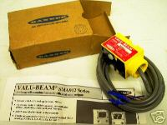
Error-Proofing Motion-Step Methods
7 Steps of Poka-Yoke
Motion-Step Methods
Place photo-electric switches into each component bin. Beam must be broken on each bin before conveyor will move
Motion sensors to stop a machine to prevent safety errors
Reprinted with permission from BigPhotoStock.com
Notes:
DO: Review examples.

Slide 38
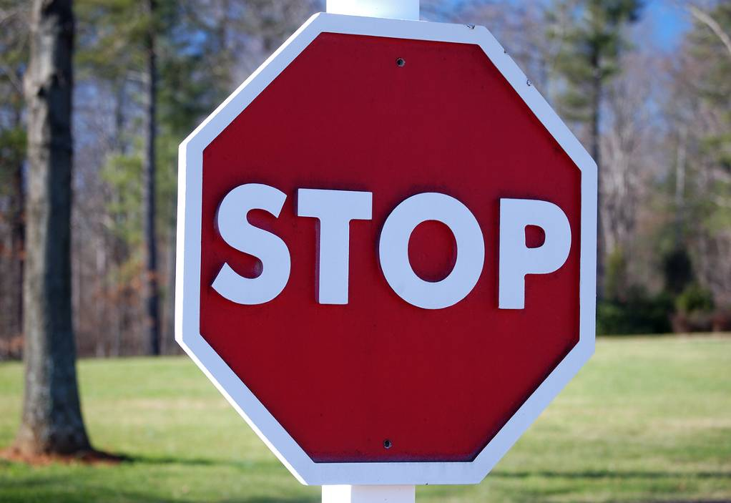
Develop a Line-Stop Support Plan
7 Steps of Poka-Yoke
Line-Stop Support Plan
Establish line stop response assignments
Identify who does what when the line is stopped
Operators, Supervisors, Managers, etc.
Reprinted with permission from BigPhotoStock.com
Notes:
SAY: “For detection methods and warning methods, it is important that a plan is in place and well practiced for what to do if the line needs to be stopped. Everyone needs to know who does what, and they need to be counted on to do their part so that the process can be trusted.”
ASK: “What happens in an andon environment when an operator flips the switch to red, and no one responds… he/she ultimately has to go get the supervisor…”

Slide 39
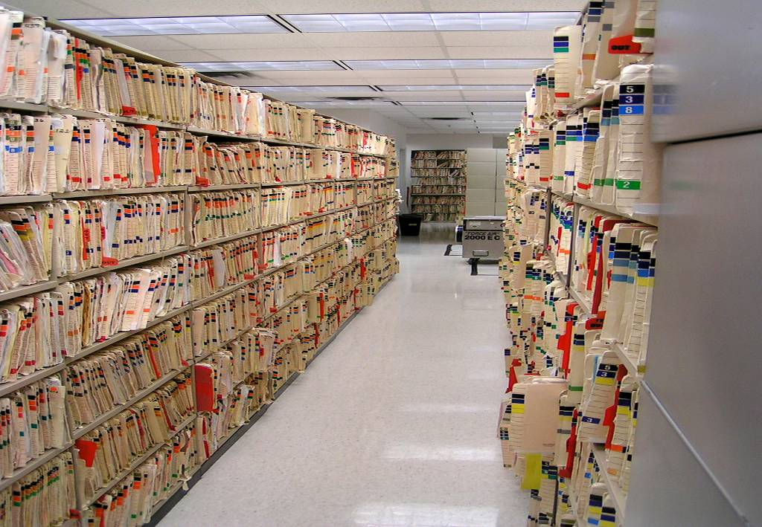
When you can’t error-proof – Improve Visual Management
Building Quality Into the Cell
Use colors and color-coding
  Filing
  Credit card receipts
Use shapes
  Notch a stack of forms so it is easy to tell if forms are out of order
Make it easy to do it right
  Checklists
  Effective data collection formats
  Workflow with fewer hand-offs
  Symbols
Reprinted with permission from BigPhotoStock.com
Notes:
SAY: “Error-proofing is not always possible given the process or what can be reasonably implemented during the improvement period. This slide shows some great ideas for making the process “better” in these instances.”
SAY: “With each of these examples, is it possible to pass on a defect? Yes. However, the chances are much less.”

Slide 40
Error-Proofing Summary
7 Steps of Poka-Yoke
Error-Proofing devices can
  Prevent errors from occurring
  Detect the error after it occurred
  Detect the defect after it has been made
The best error-proofing devices are
  Simple and cheap
  Part of the regular process
  Close to where the error is made
Notes:
DO: Review summary points.

Slide 41
Poka-Yoke Examples
Zero Defect
Quality System
7 Steps of Poka-Yoke
Poka-Yoke Examples
Objectives:
Identify types of poka-yokes
Review various poka-yoke examples
Review key learnings
Notes:
DO: Review section objectives on slide.

Slide 42
Types of Poka-Yoke Devices
Poka-Yoke Examples
Guide/reference/
interference rod or pin
Template
Limit switch/micro-switch
Counter
Odd-part-out method
Sequence restriction
Standardize and solve
Critical condition indicator
Detect delivery chute
Stopper/gate
Sensor
Mistake-proof your mistake-proofing device
Notes:
DO: Review examples.

Slide 43
Guide
Poka-Yoke Examples
Before Poka-yoke
After Poka-yoke
Locating
Angles
Locating
Angles
Correct
Locating
Angles
Guide Pin
Incorrect
Notes:
DO: Review examples.

Slide 44
Template
Poka-Yoke Examples
Before Poka-yoke
After Poka-yoke
Manual measuring and layout of trim periphery
Locating Holes
Panel Trim Lines
Trim Template
Locating
Holes
Panel Trim Lines
Notes:
DO: Review examples.

Slide 45

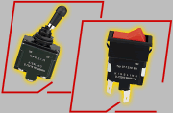
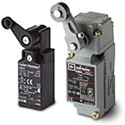

Limit Switch
Poka-Yoke Examples
Toggle Switches
Limit Switches
Notes:
DO: Review examples.

Slide 46
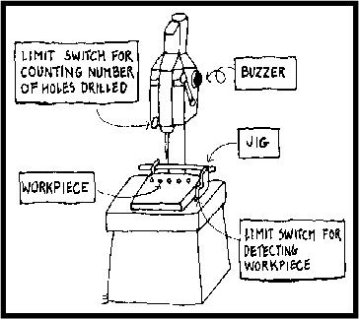
Counting Method
Poka-Yoke Examples
Used when a fixed number of operations are required within a process, or when a product has a fixed number of parts that are attached to it.
A sensor counts the number of times a part is used or a process is completed and releases the part only when the right count is reached.
Notes:
DO: Review examples.

Slide 47
Odd Part Out
Poka-Yoke Examples
A contact method functions by detecting whether a sensing device makes contact with a part or object within the process.
Cylinder present
Missing cylinder;piston fully extended alarm sounds
An example of a physical contact method is limit switches that are pressed when cylinders are driven into a piston. The switches are connected to pistons that hold the part in place. In this example, a cylinder is missing and the part is not released to the next process.
Cannot proceed to next step
Contact Method using limit switches identifies missing cylinder.
Notes:
DO: Review examples.

Slide 48
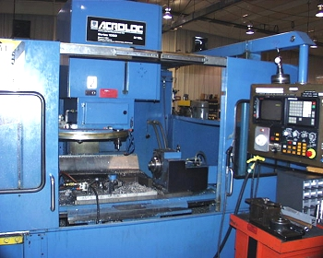
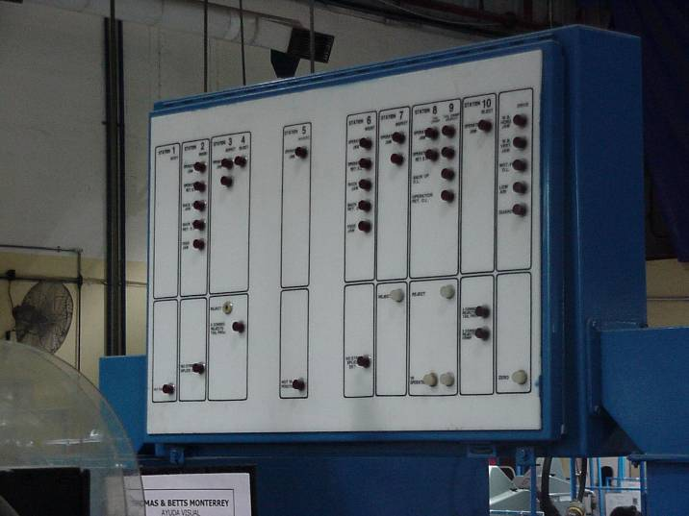
Sequence Restriction
Poka-Yoke Examples
Machine
Indicator Board
Notes:
DO: Review examples.

Slide 49
Standardize and Solve
Poka-Yoke Examples
Before Poka-yoke
After Poka-yoke
Correct
Fire Extinguisher Reservoir Bottles
Hose to Area B
Hose to Area A
Hose to Area A
Fire Extinguisher Reservoir Bottles
Hose to Area B
Incorrect
Fire Extinguisher Reservoir Bottles
Female
Male
Hose to
Area B
Different size connectors
Hose to Area A
Notes:
DO: Review examples.

Slide 50
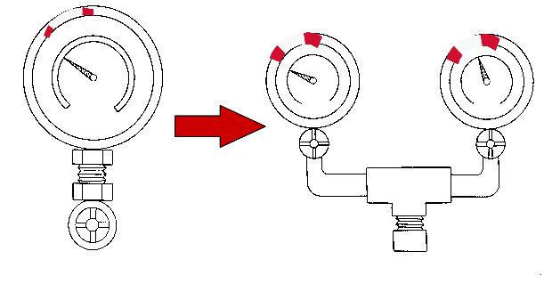
Critical Condition Detector
Poka-Yoke Examples
Is this gauge reading reliable?
Notes:
DO: Review examples.

Slide 51
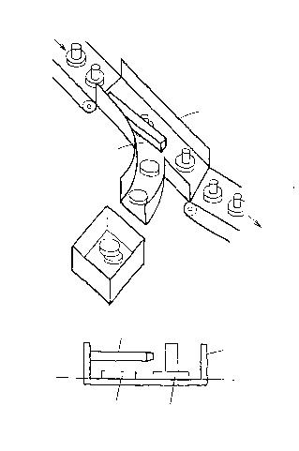
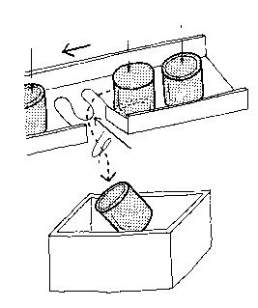
Delivery (Detect) Chute
Poka-Yoke Examples
from welding
right side up
_{B}
upside down
chute
chute
sorting arm
notch
retrieval bin
to next process
_{A}
sorting arm
chute
unwelded bushing
good item
Notes:
DO: Review examples.

Slide 52
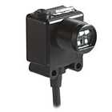
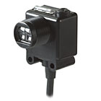
Sensor
Poka-Yoke Examples
Light
Transmitter
Receiver
Object
If object breaks the transmission, the machine is signaled to shut down
Notes:
DO: Review examples.

Slide 53
Review Exercise
Poka-Yoke Examples
2 Minute Review
  In pairs, or in small groups, spend 5 minutes discussing key learnings and take-aways from this Poka-yoke Event thus far
  One person from each group will share one learning that was discussed with the rest of the class

Slide 54
Summary
Poka-Yoke Examples
Zero defects is possible
All processes can become error free
Seek out the root cause
Look for Red Flag Conditions
Poka-yoke is a change in attitude

Slide 55
Other Modules In This Series:
5S
Standard Work
Total Productive Maintenance (TPM)
Administrative Lean
Cell Design/ Production Preparation Process (3P)
Kaizen
Kanban
Problem Solving
Poka Yoke Quality Systems
Transaction Process Improvement (TPI)
Cause & Effect Diagram with the Additions of Cards (CEDAC)
Single Minute Exchange of Dies (SMED)
Value Stream Mapping (VSMi®)
Visual Management
Managing Daily Process Excellence
For More Information Please Contact:
Mark DeLuzio, President and CEO
+1.860.234.0915
mark.deluzio@leanhorizons.com
Strategically Creating Value Through the Elimination of Waste

